Slide 1
SUPERSTORE Data (Retail Sales and Inventory )
Final Internship Report

Slide 2
Team Member
Our team combine creativity , strategy, and precision to bring bold vision for this project . From concept to runway , each member plays a vital role in improving the project superstore sales and inventory Analysis.
01
02
03
Atithi Singh
Kalpna Reddy
S Hussan

Slide 3
Table Of Content
Project Overview
Objective & Goals
Tool & Technology
Data Preparation & Querying
Power Bi Dashboard
Screenshot
Conclusion

Slide 4

Project Overview
End-to-End Workflow
Transforms raw retail data into actionable insights through data cleaning in Python, querying in SQL, and visualization in Power BI.
Strategic Decision-Making
Delivers interpretable dashboards and business recommendations to drive smarter decisions around products, regions, and customers.
Multi-Dimensional Analysis
Uncovers patterns in sales trends, product performance, geographic distribution, and customer purchasing behavior.

Slide 5
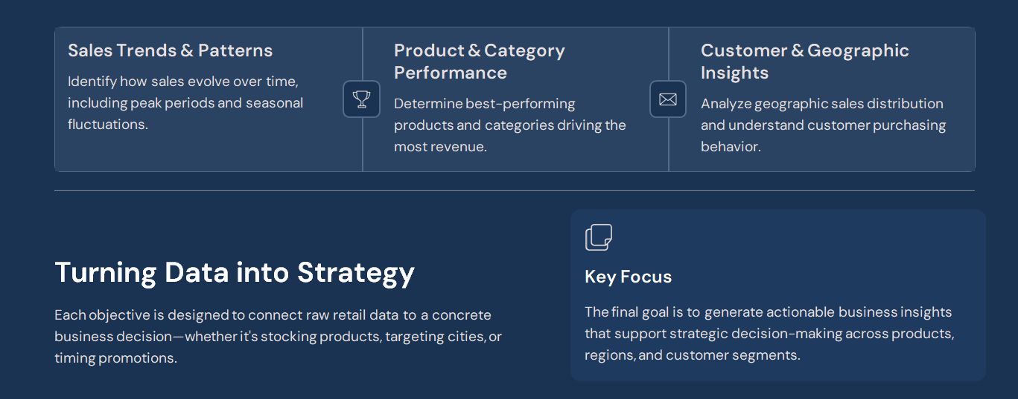
Objective & Goals

Slide 6




Tool & Technologices
Python (Pandas)
SQL (MySQL)
Data cleaning and preprocessing — handling missing values, removing duplicates, and standardizing formats.
Data analysis using GROUP BY, ORDER BY, and aggregate functions like SUM, AVG, and COUNT.
Power BI
Git & GitHub
Interactive dashboard creation for visualizing revenue, product performance, and sales trends.
Version control for tracking changes, collaborating, and maintaining a clean project history.

Slide 7
Data Preparation & Querying
From Raw Data to Structured Insights
01
02
Clean & Standardize
Import into MySQL
Used Python (Pandas) to handle missing values, remove duplicates, standardize date/time formats, and correct data types for a structured dataset.
Loaded the cleaned dataset into MySQL for structured querying and relational analysis across product, city, and category dimensions.
03
Analyze with SQL
Applied GROUP BY aggregations, ORDER BY sorting, and aggregate functions (SUM, AVG, COUNT) to extract meaningful business metrics.

Slide 8

Power Bi Dashboard
Payment Methods
Payment Methods
Product Performance
Product Performance
Total Profit
City-wise Sales
Total Revenue
City-wise Sales
Category Contribution
Category Contribution
Revenue & Products
Geography & Payments
Sales Over Time
Tracks total revenue and highlights best-performing products and categories like Electronics and Fashion.
Visualizes city-wise sales distribution with key markets like Hyderabad and Pune, and tracks digital vs. other payment methods.
Displays trends to identify peak sales hours and periods, enabling targeted promotional scheduling.

Slide 9
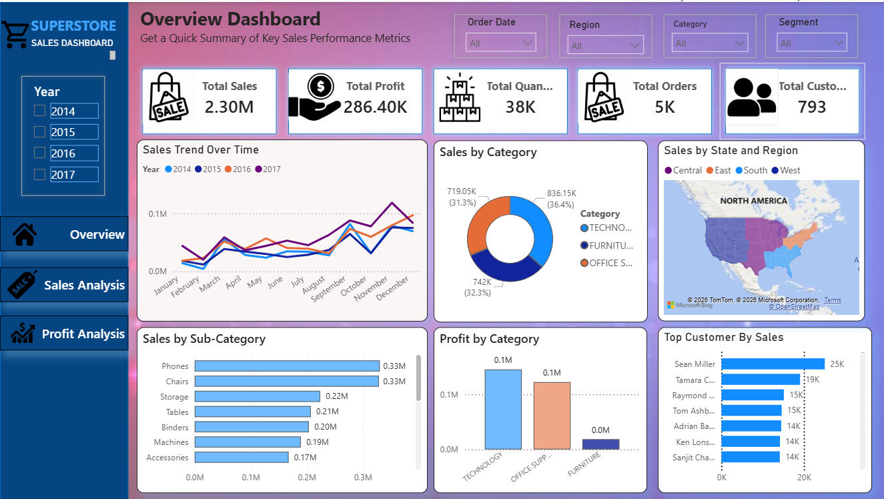
ScreenShots

Slide 10
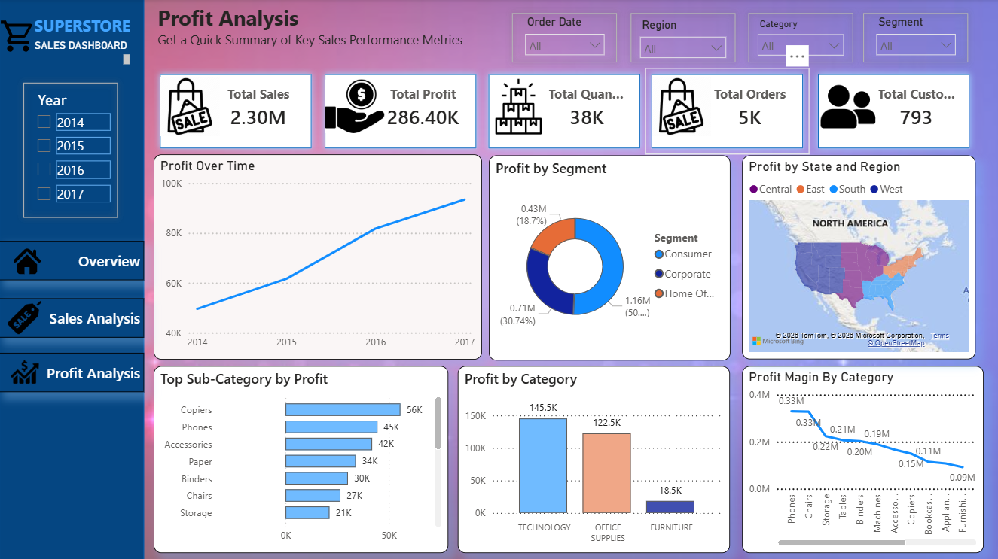
ScreenShots

Slide 11
Conclusion
This project demonstrates an end-to-end data analysis workflow, transforming
raw retail data into meaningful insights using Python, SQL, and Power BI.
The analysis highlights that sales performance is driven by a combination of
product demand, regional contribution, and customer purchasing behavior.
Categories such as Electronics and Fashion play a major role in revenue

